Slide 1
MATHEMATICS AND BIOSTATISTICS REVIEW
Joseph DeAlteris
University of Rhode Island
Department of Fisheries and Aquaculture
Kingston, RI 02881

Slide 2
Purpose
Provide a review of mathematics and biostatistics used in support of fish stock assessments to individuals with some background in these subjects.

Slide 3
Presentation Outline
Introduction
Functions: linear and non-linear
Powers and roots
Exponentials and logarthms
Differential and integral calculus
Differential equations
Descriptive statistics
Hypothesis testing
Fitting models to data

Slide 4
Why Mathematics and Biostatistics?
Goal of fish stock assessment is to predict outcomes under various management strategies and to quantify uncertainty in predictions due to variability in input data.

Slide 5
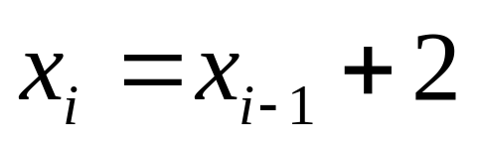
Mathematical models allow for prediction:
2, 4, 6, 8, 10, __, __, __
so,
x₆ = 12, x₇ = 14, x₈ = 16

Slide 6
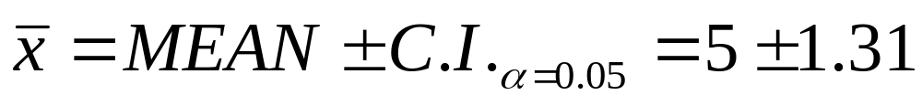
Statistics allow quantification of uncertainty in predictions:
Sample of individual fish weights, what is the average weight?
8, 5, 6, 4, 3, 7, 5, 6, 4, 2

Slide 7
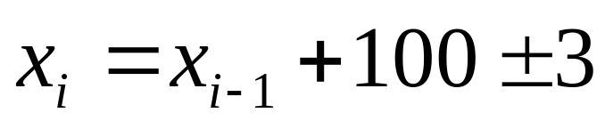
Combining models and statistics:
Question
Given a series of numbers:
98, 202, 299, 403, 498, …, note variability of +/- 3
What are the next three numbers in the series?
Model
Answer
600 ± 3, 700 ± 3, 800 ± 3, ...

Slide 8
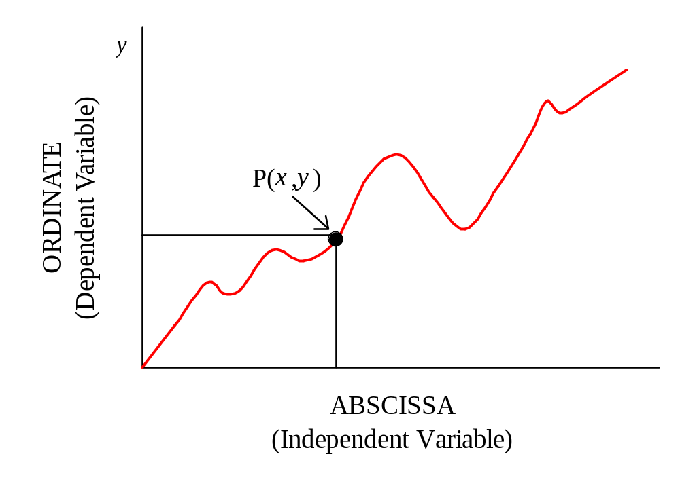
Function: y = f (x)
x

Slide 9
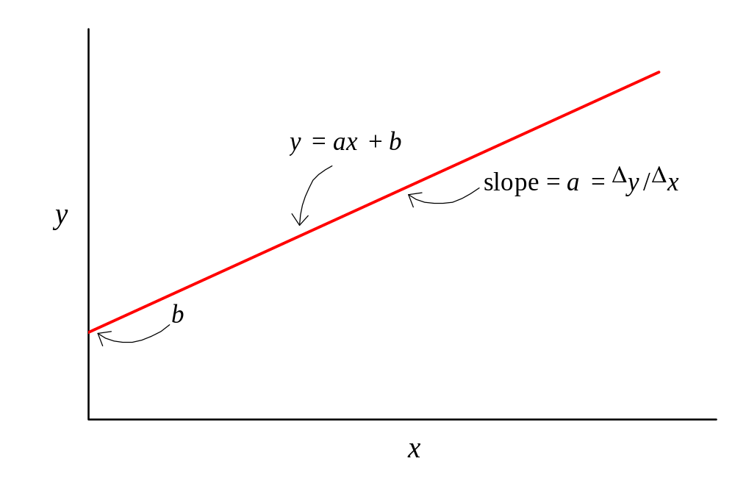
Linear Function: y = ax + b

Slide 10
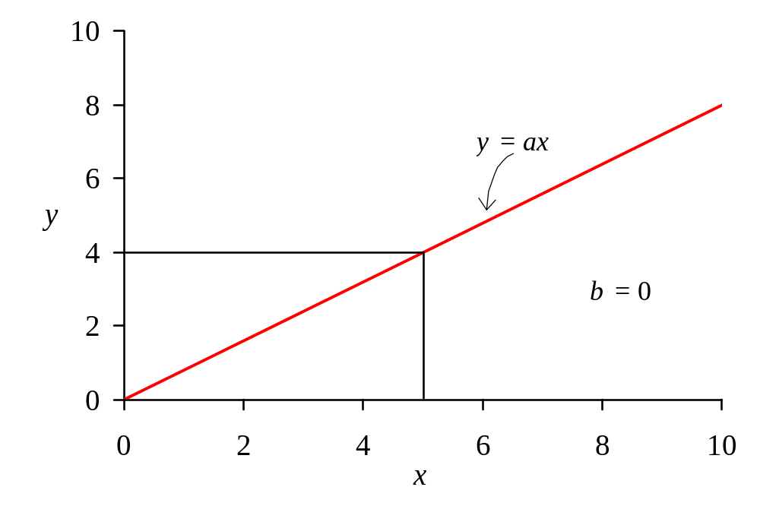
Special Case of Linear Function: y = ax

Slide 11
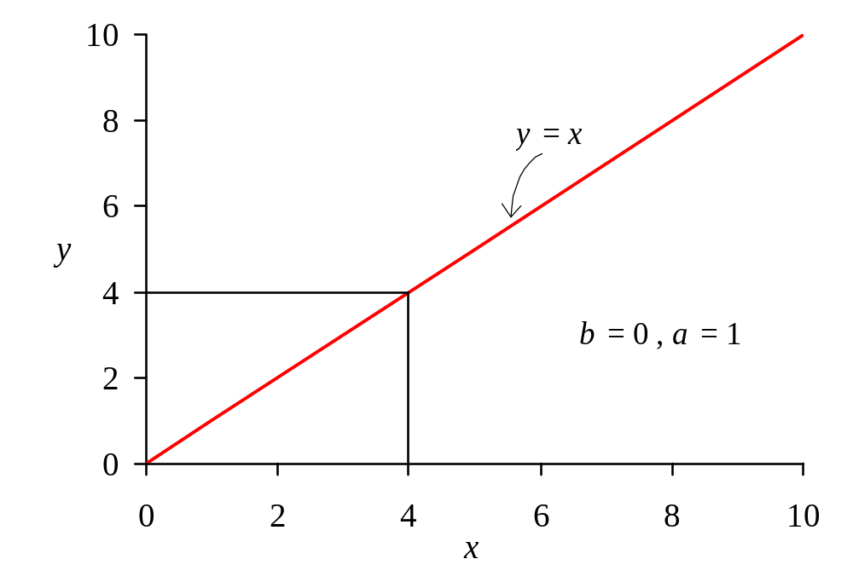
Special Case of Linear Function: y = x

Slide 12
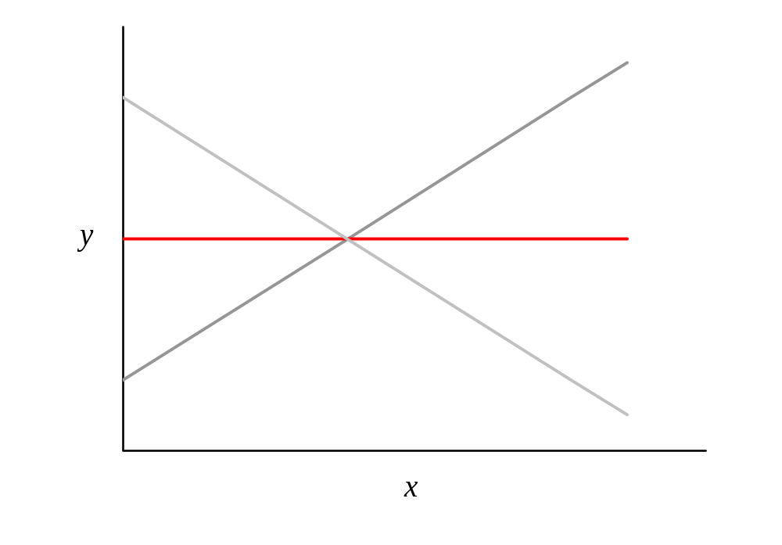
Effect of Slope (a) on the Linear Function
a > 0
a = 0
a < 0

Slide 13
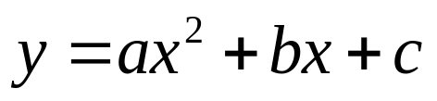
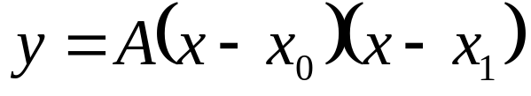
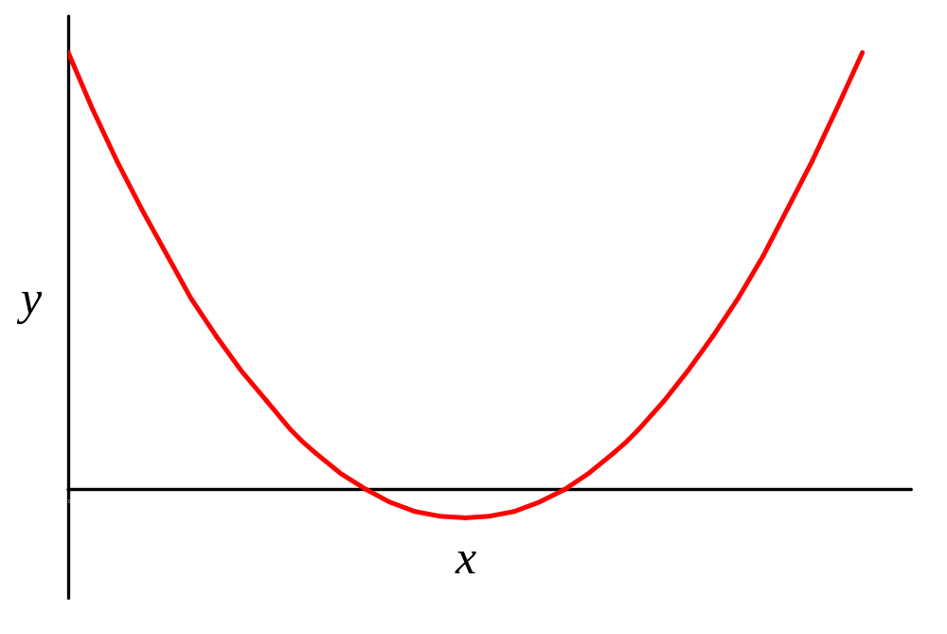
Non-linear Functions: Quadratic Function
or
If A > 0
x₀
x₁

Slide 14
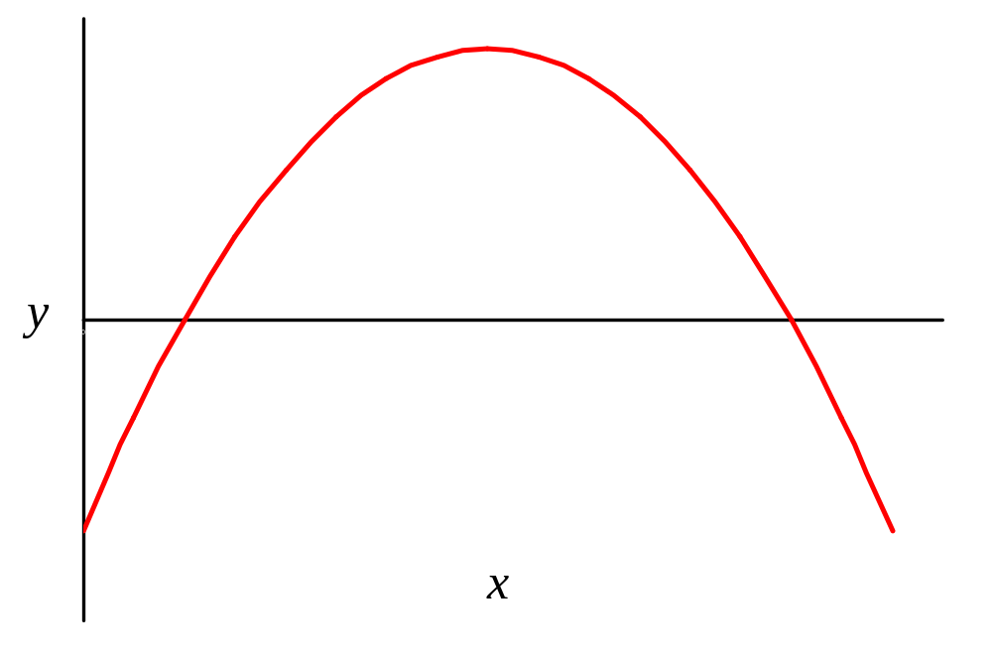
Non-linear Functions: Quadratic Function
or
If A < 0
x₀
x₁

Slide 15
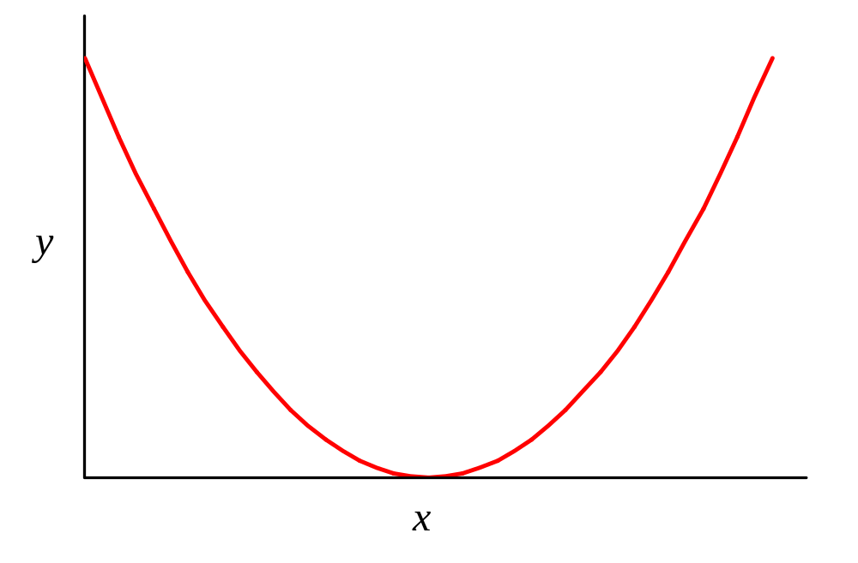
Non-linear Functions: Quadratic Function
or
If A > 0, and x₀ = x₁

Slide 16
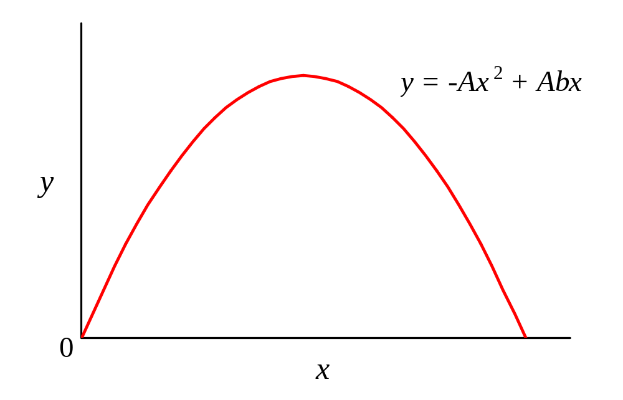
Non-linear Functions: Quadratic Function
or
If A < 0, and x₀ = 0 and x₁ = b
b

Slide 17
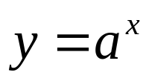
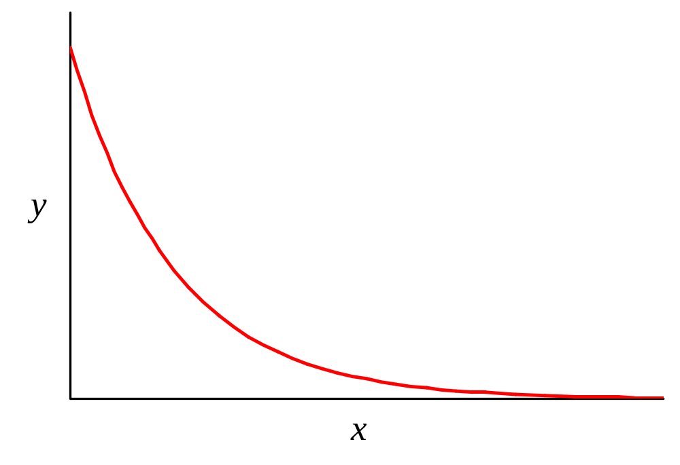
Non-linear Functions: Exponential Function
If a < 1:
1

Slide 18
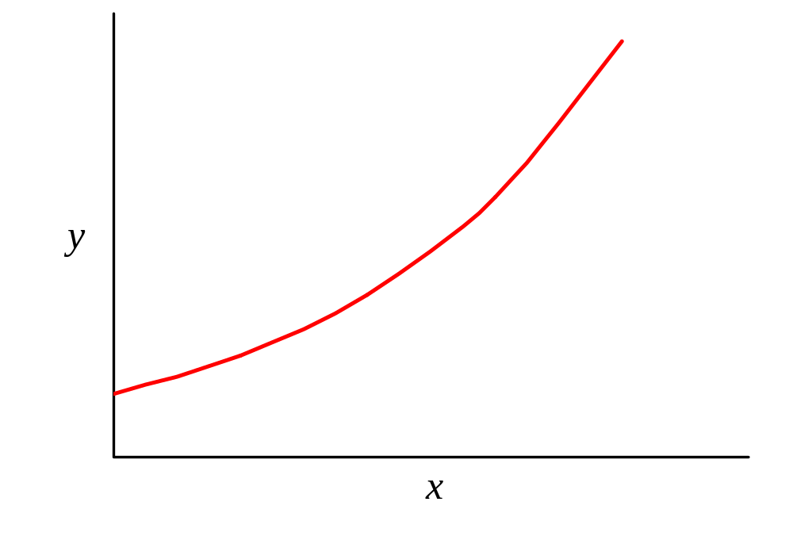
Non-linear Functions: Exponential Function
If a > 1:
1

Slide 19
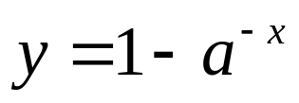
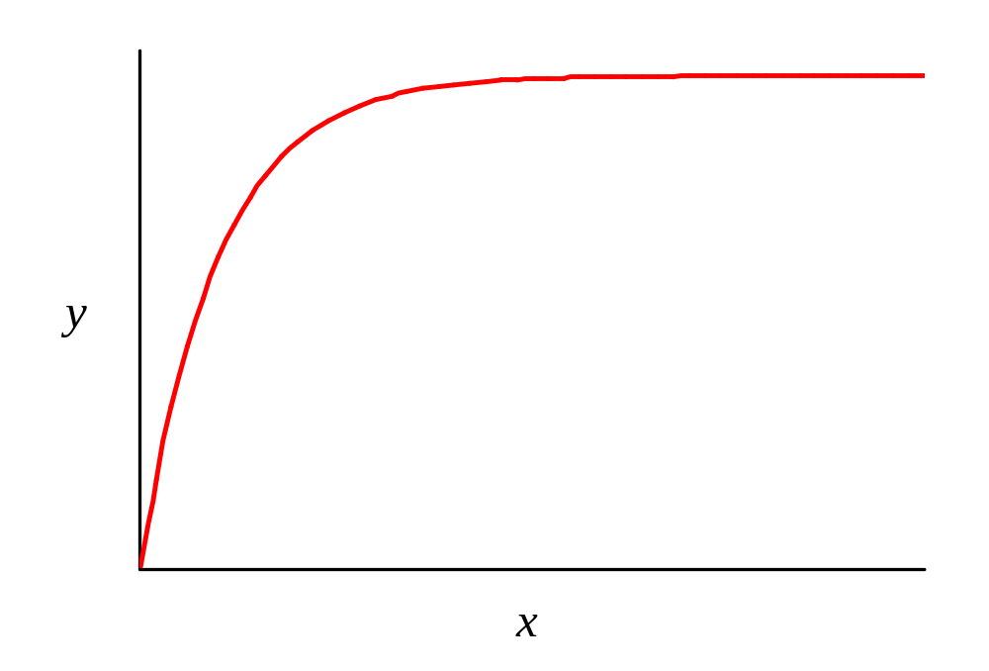
Non-linear Functions: Asymptotic Function
1

Slide 20
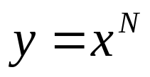
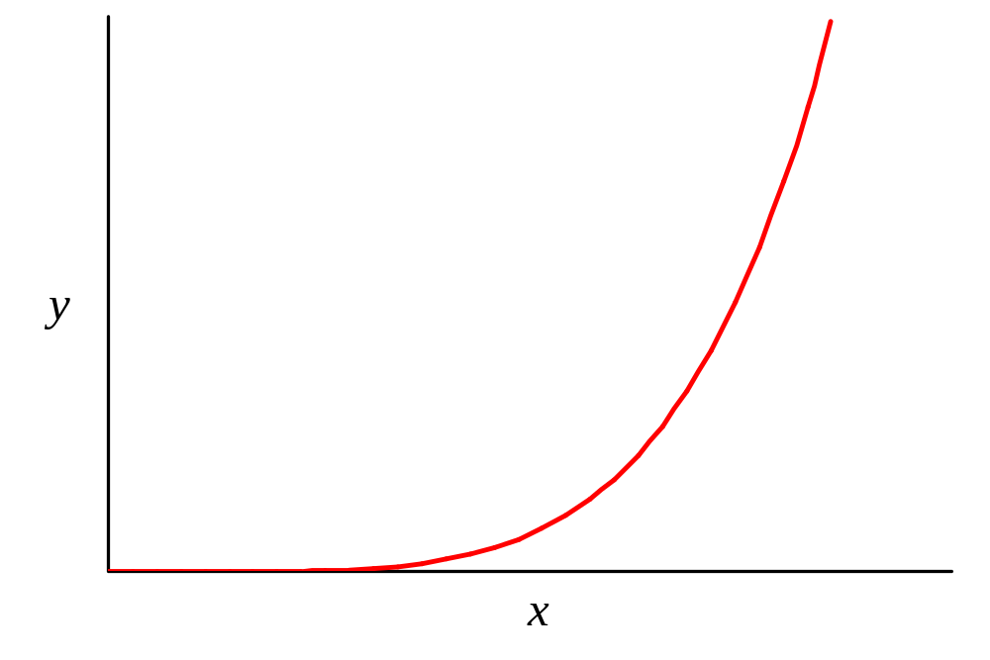
Non-linear Functions: Power Function
If N > 1:

Slide 21
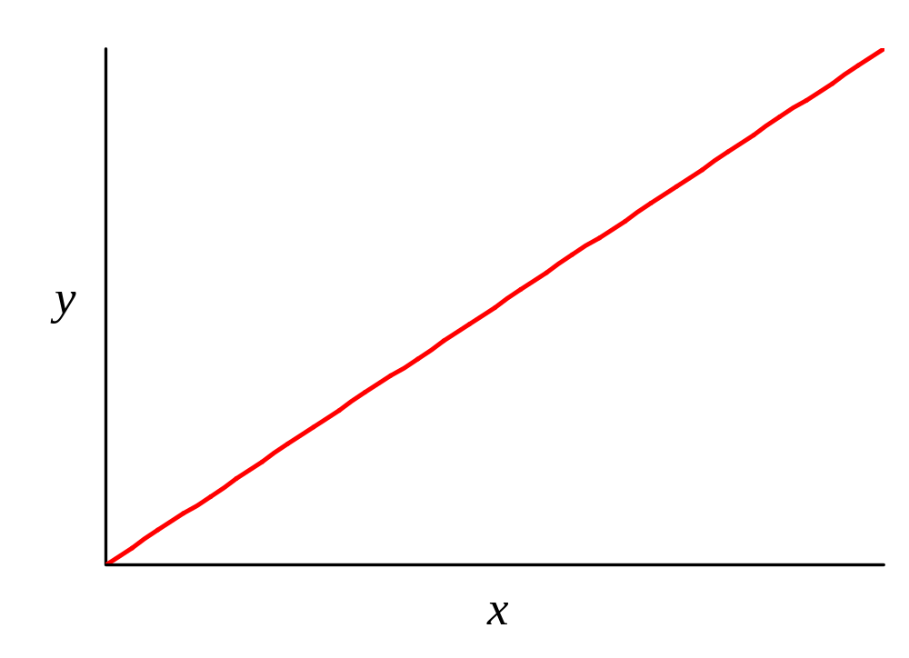
Non-linear Functions: Power Function
If N = 1:

Slide 22
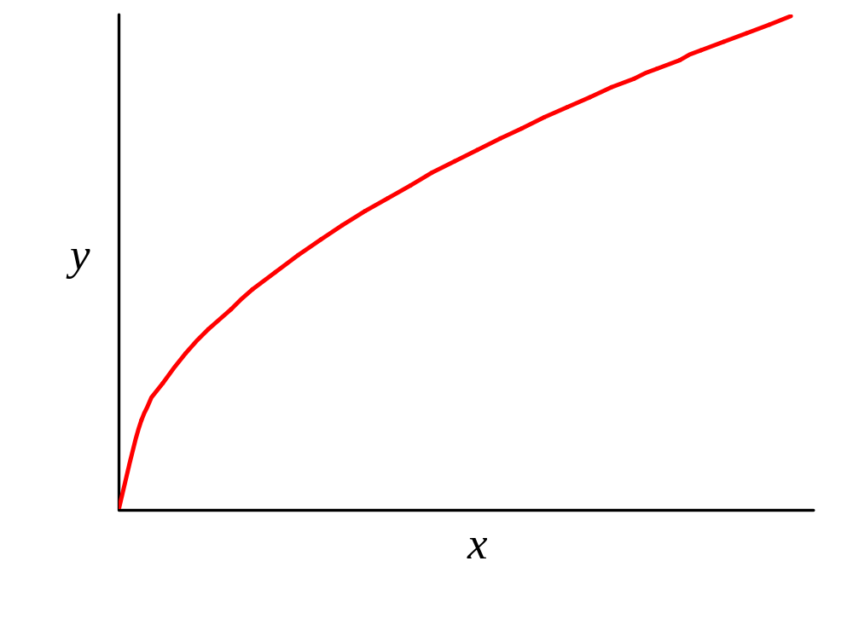
Non-linear Functions: Power Function
If N < 1:

Slide 23
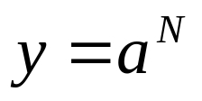
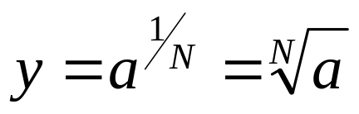
Power and Roots
Power:
where a is the base, and
N is the exponent
Root is the inverse of a power:

Slide 24
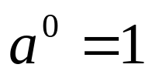
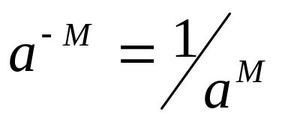
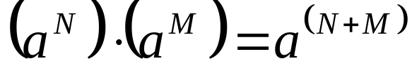
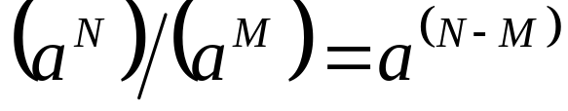
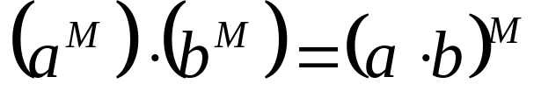
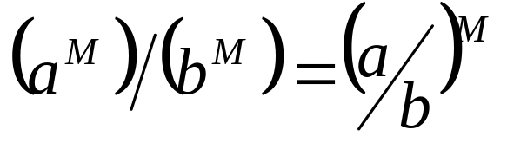
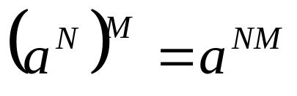
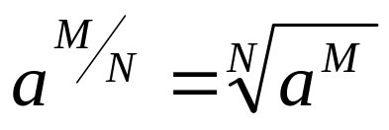
Power Laws

Slide 25

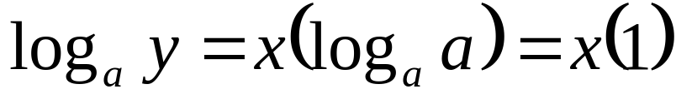
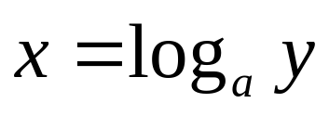
Exponentials and Logarithms
Exponential:
Logarithms are the inverse of an exponential
where a is the base

Slide 26
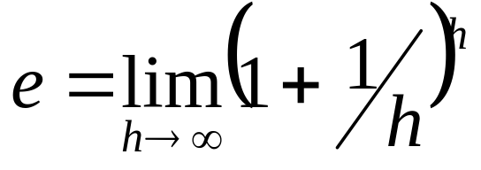
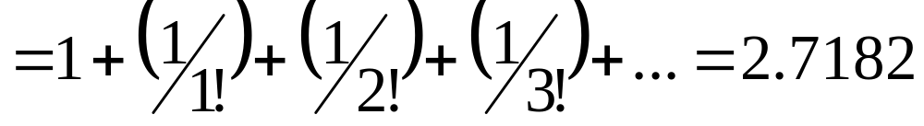
Common Logarithm Bases
2 → log₂, Binary System
e = 2.7 → log_{e} = ln, Napierian System
10 → log₁₀, Numeric System
Note:
where “!” indicates “factorial” (i.e., a series product of descending integers)

Slide 27
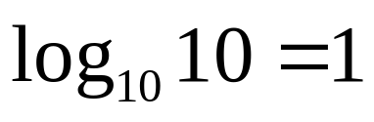
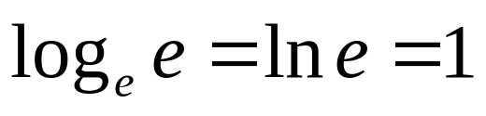
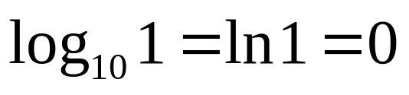
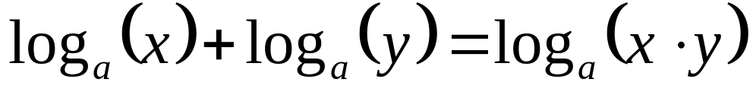
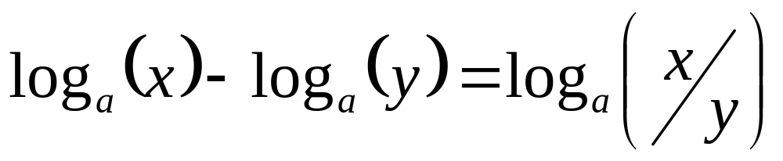
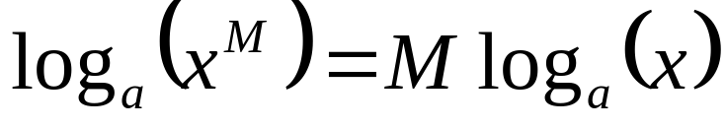
Logarithm Laws

Slide 28
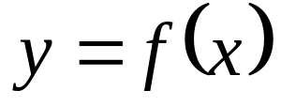
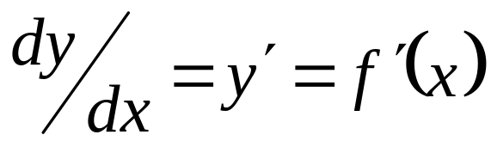
Differential Calculus: rate of change
Derivative of a function indicates the rate of change of “y” with respect to “x” at any point “x.”

Slide 29
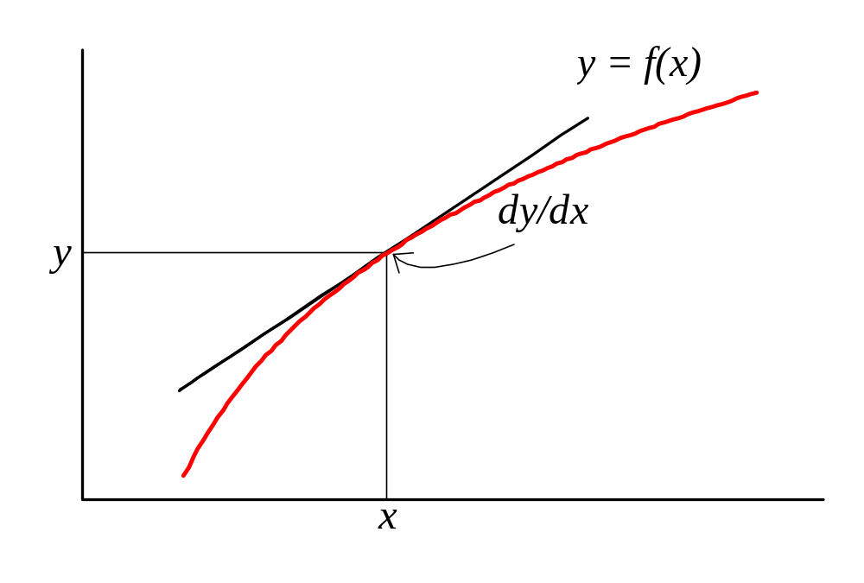
Derivative of a Function

Slide 30



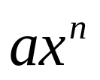
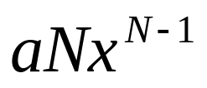
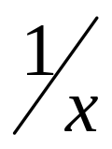

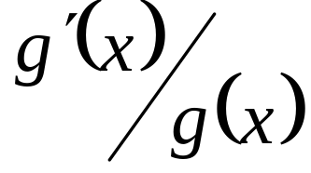






Derivatives of Generalized Functions
Function Derivative
(constant)

Slide 31


Given a parabolic function:

Slide 32


Find the derivative of the parabolic function:

Slide 33







Find the maximum of the parabolic function:
Set derivative (slope) = 0
Substitute the value of x into the original equation:
Thus, the coordinates of the y-max for the parabolic function are:

Slide 34



Parabolic Function
y_{MAX}
x at y_{MAX} =

Slide 35

Integral Calculus: summing changing quantities; or the inverse of differentiation
Integral of function y = f(x), between lower bound, x = a and upper bound x = b is:

Slide 36

Integral of Function: y = f(x)

Slide 37








Integral of Generalized Functions

Slide 38


Differential Equation
A differential equation is a function that includes a derivative. Conceptually, an equation that includes one variable that changes with respect to another variable.
or

Slide 39

Plot of Differential Equation

Slide 40






Solution to Differential Equation by Separation of Variables

Slide 41

Plot of Solution to Differential Equation

Slide 42
Descriptive Statistics
Describe properties of a set of data.
Characterize central tendencies and variability.
If based on random samples, can make inferences about the population.

Slide 43

Measures of Central Tendency in the Data
Mean: the average value,
Median: value half way between the
extremes in a ranked data set
Mode: data point with the greatest number of observations

Slide 44



Measures of Variability in the Data
Estimate Variance:
Standard Deviation:
Standard Error:

Slide 45

The Coefficient of Variation (C.V.) is a measure of variability relative to the mean

Slide 46

Consider a sample of 20 measures of fork length (cm) for fish taken from RI salt pond:

Slide 47

Length data grouped into integer categories:

Slide 48

Plot of Length-Frequency Distribution

Slide 49


The descriptive statistics are:
Sample size = n = 20
Mean = = 17.5 cm
Variance = s² = 2.0 cm²
Standard Deviation = s = 1.4 cm
S.E. = 0.32
Median = 17.6 cm
Mode = 17 cm

Slide 50
Hypothesis Testing
Statistics used to evaluate hypotheses.
Null hypothesis (H₀).
Alternate hypothesis (H₁).
Use confidence intervals (C.I.).

Slide 51


Confidence Interval (C.I.)
Where is the mean,
S.E. is the standard error, and
is the t statistic for sample size n and significance level 1-α.

Slide 52
Fish fork lengths from two ponds:
Pond One 17.5 ± 0.64 cm = 16.9 ≤ x ≤ 18.1 cm
Pond Two 16.4 ± 0.60 cm = 15.8 ≤ x ≤ 17.0 cm

Slide 53

Mean and Confidence Intervals of Fish Fork Lengths from Two Ponds

Slide 54

Fitting Models to Data
Using regression analysis applied to weight-length data, fit a model to predict fish weight at any length.
Where W is weight in grams,
L is length in centimeters,
a is a unit conversion coefficient, and
b is the volumetric expansion coefficient.

Slide 55

Given the following length and weight data, estimate the parameters a and b for this fish species:

Slide 56

Non-Linear Model:
W = 0.0055L^{3.12}

